Slide 1
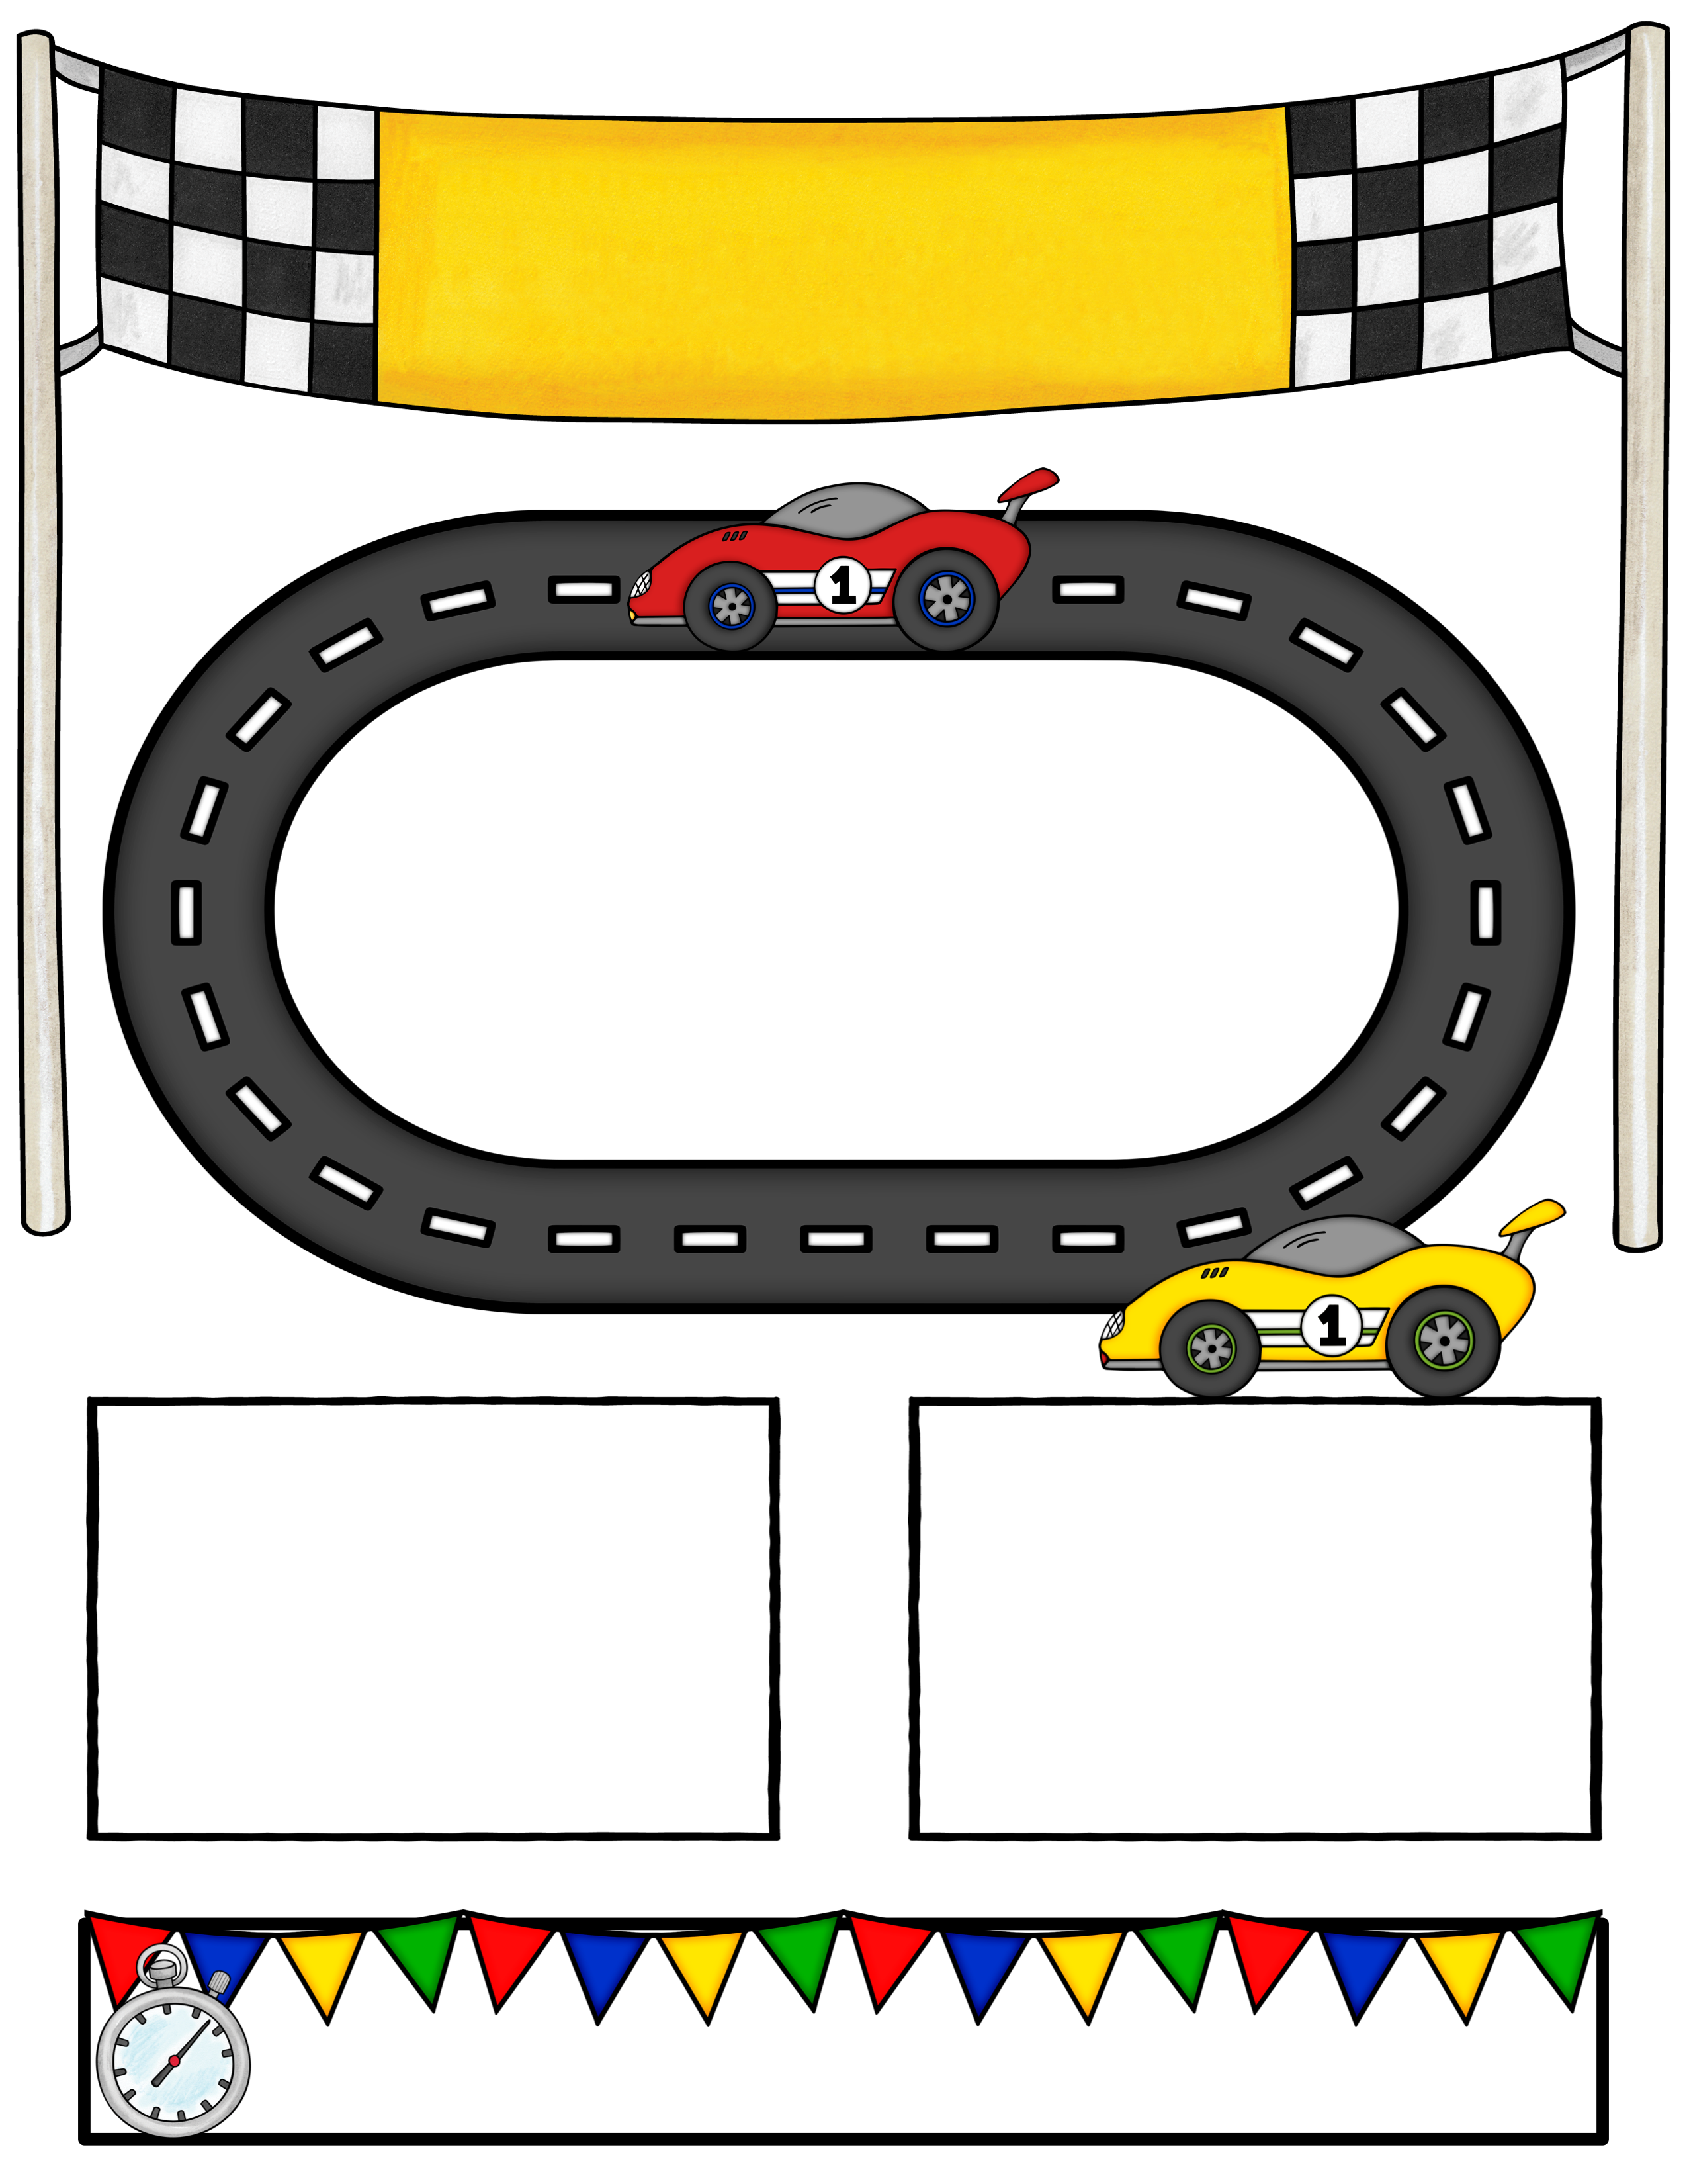
Open House
Welcome Back Eagles!
We are so excited for our new school year where we will be…
“Racing Towards Success!”
When: Monday, July 11th 5-7
First Day of School: Tuesday, July 12th
We are asking each family to bring in a nonperishable item to help restock our “Eagle Pantry”.
To show our thanks your child with get a special Eddie the Eagle sticker.
During this time you can meet with your teacher and drop off school supplies.
We will also have MANY community vendors in our cafetería for your family to visit.
Eagle’s Nest will be taking enrollments and our PTO will be selling spirit shirts.
East Elementary a school of excellence!
Teacher letters will be mailed July 5th.
Please call the school if you don’t receive your letter.

Slide 2
You are cordially invited to attend our 2022-2023
East Elementary Open House.
When: Monday, July 11, 2022, 5:00-7:00
Our families will have an opportunity to visit with their teachers. Along with visiting MANY community businesses who support our school year-round.
Eddie the Eagle will even be making an appearance!
East Elementary a school of excellence!
Racing Towards Success
at East Elementary
2022-2023

